Slide 1
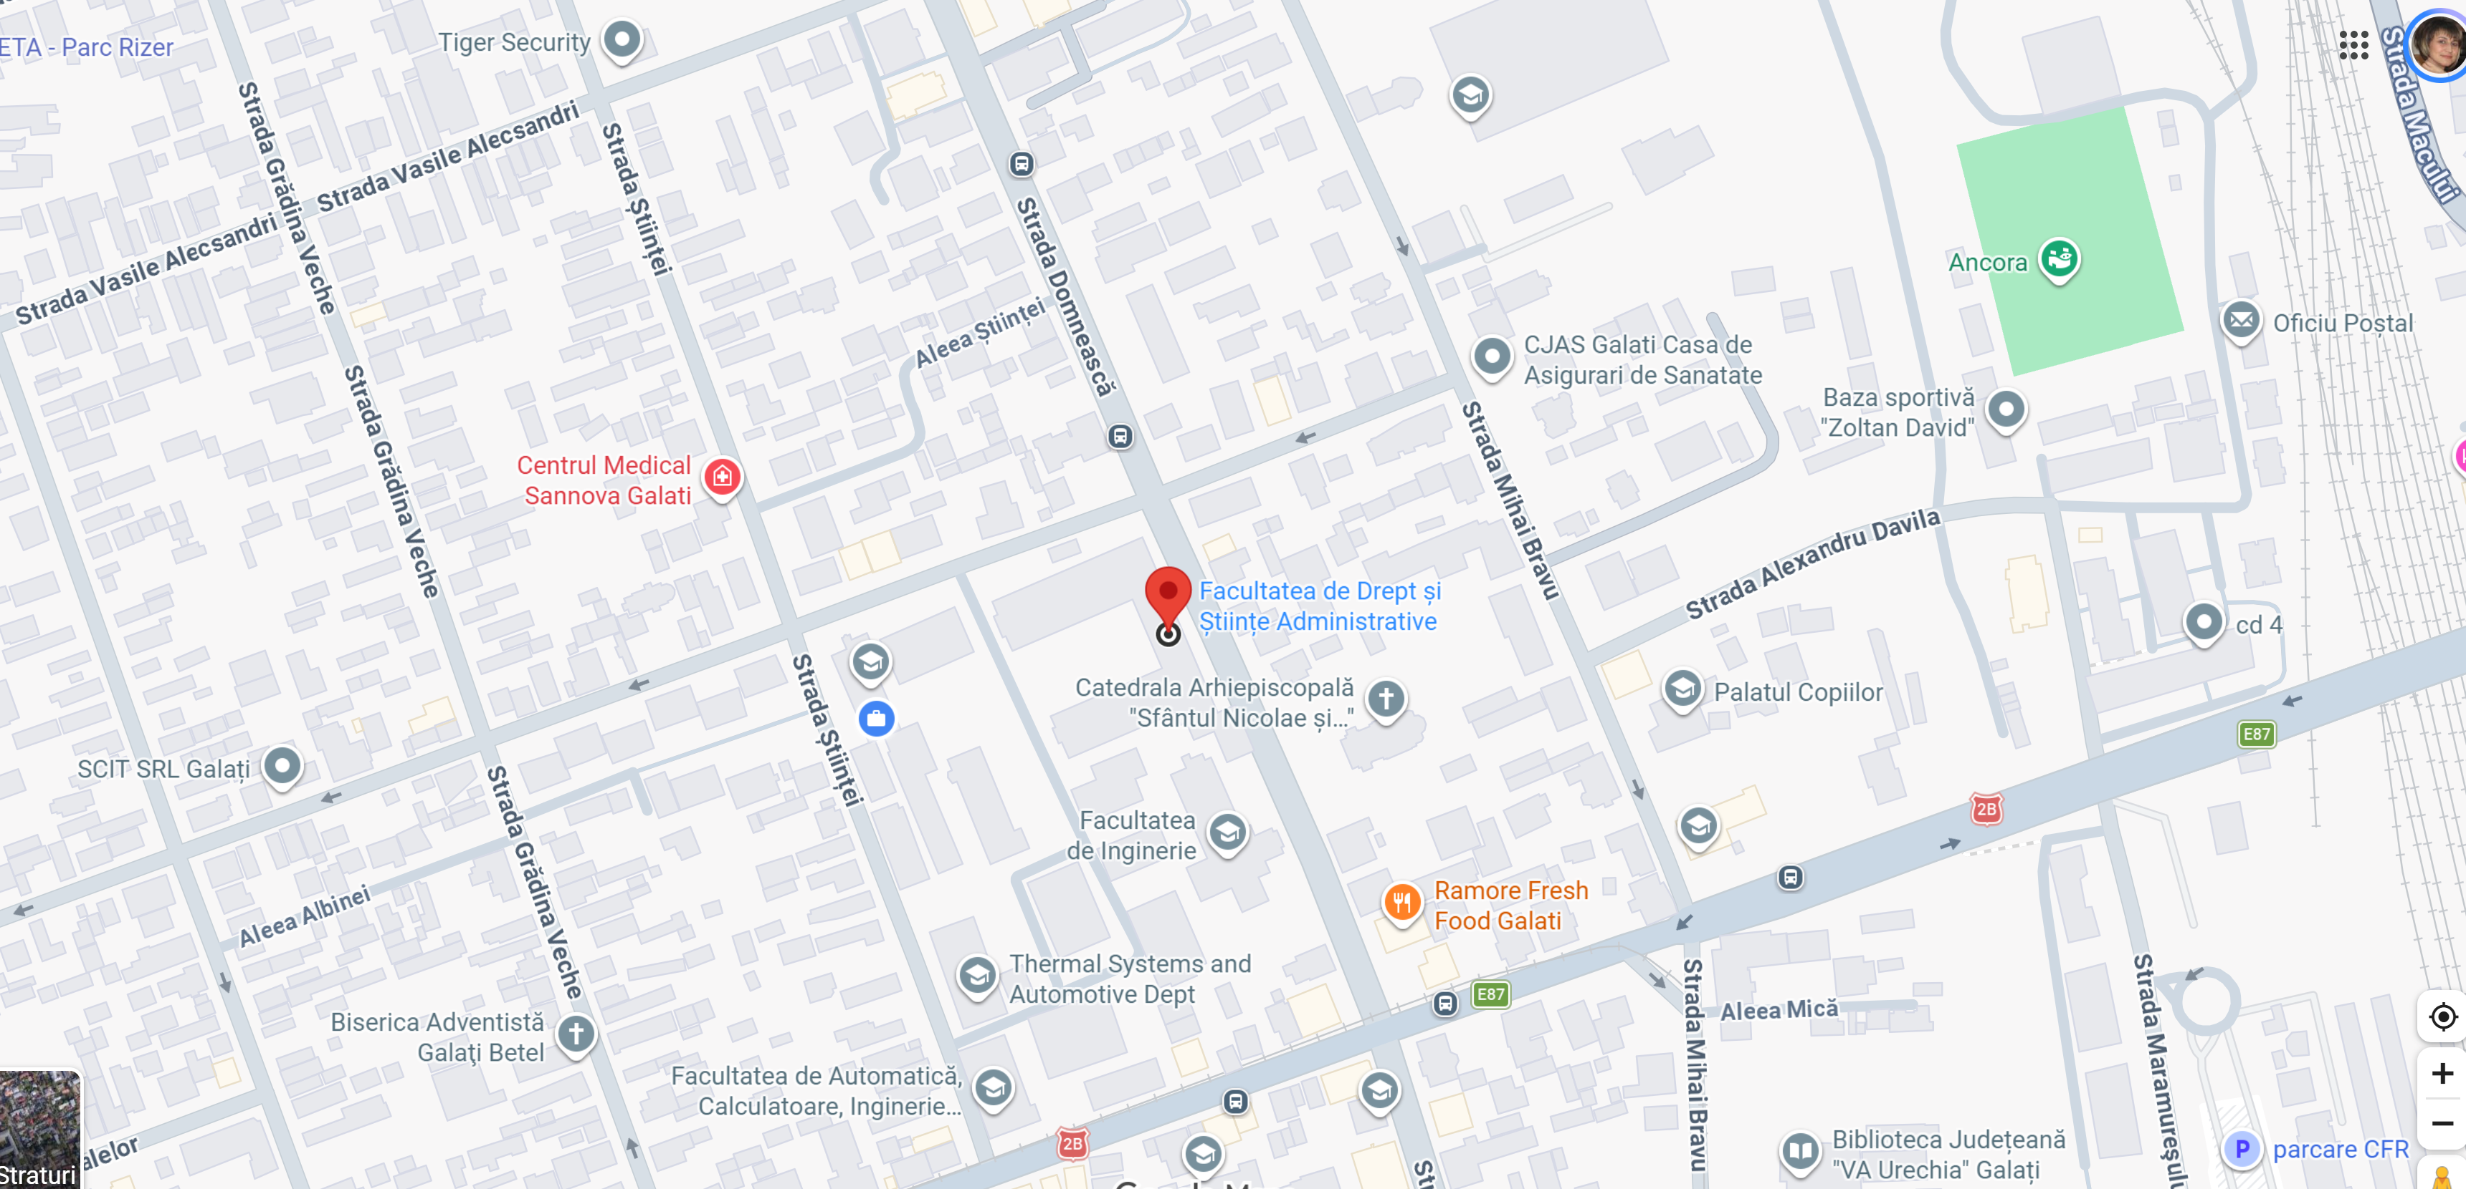
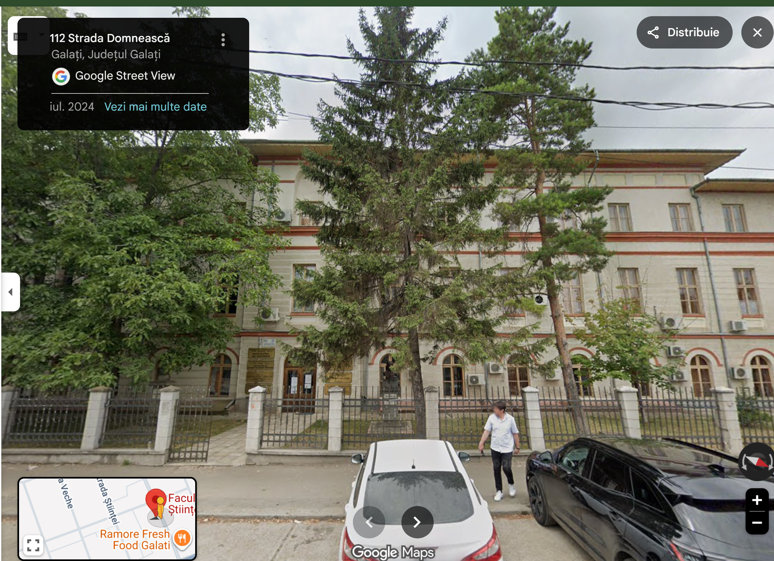
Meeting Location:
Dunarea de Jos University of Galati
Aula Magna Room
Domneasca Street no. 111, Galati, Romania
Google Maps

Slide 2
Traveling to Meeting Location:
Nearest airport – Otopnei Bucharest Airport
Taxi
It is a distance of about 250 km from the airport to Galati City (between 3 h and 3 and 1/2h); price is more than 100 EUR per car/trip.
2. Shuttle transport
Bucharest-Galati
Races coach București - Galați | Autogari.RO
Galati – Bucharest
Races coach Galați - București | Autogari.RO
3. By train
There is direct connection between Bucharest airport and Bucharest Main train station at every 10 or 15 min.
At Bucharest Main Train Station, you can buy tickets on site or online. Please find a suitable departure time by accessing the link below
Train routes + tickets - Integrated tickets

Slide 3
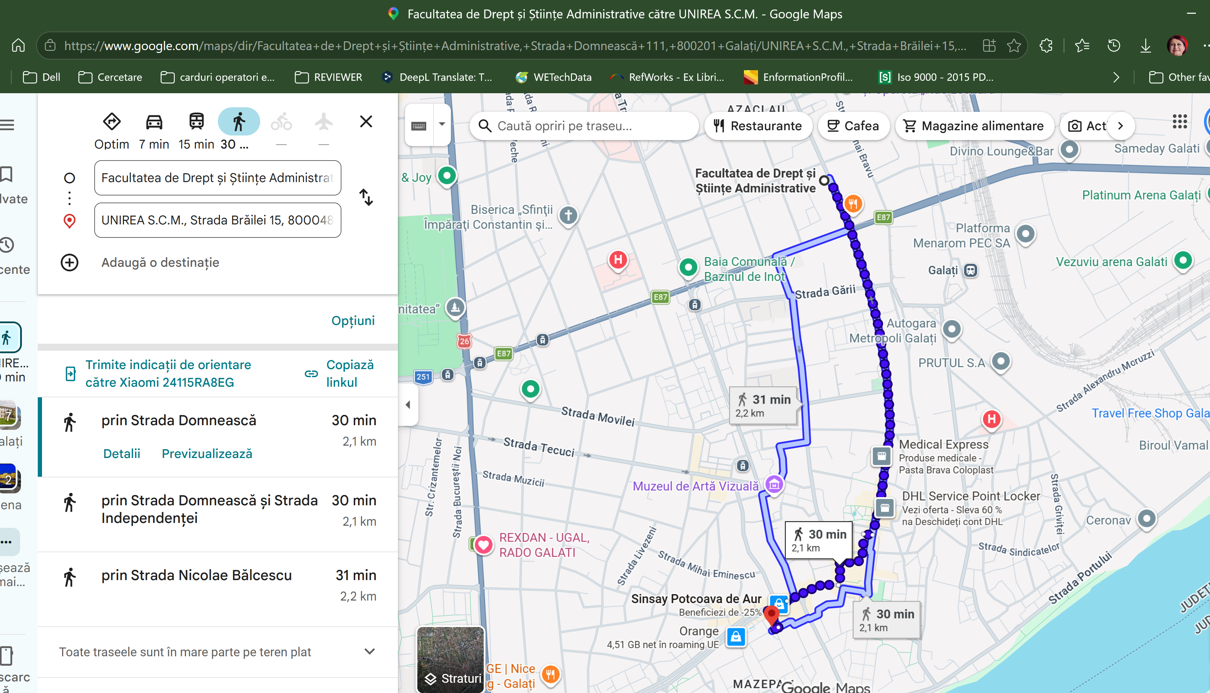
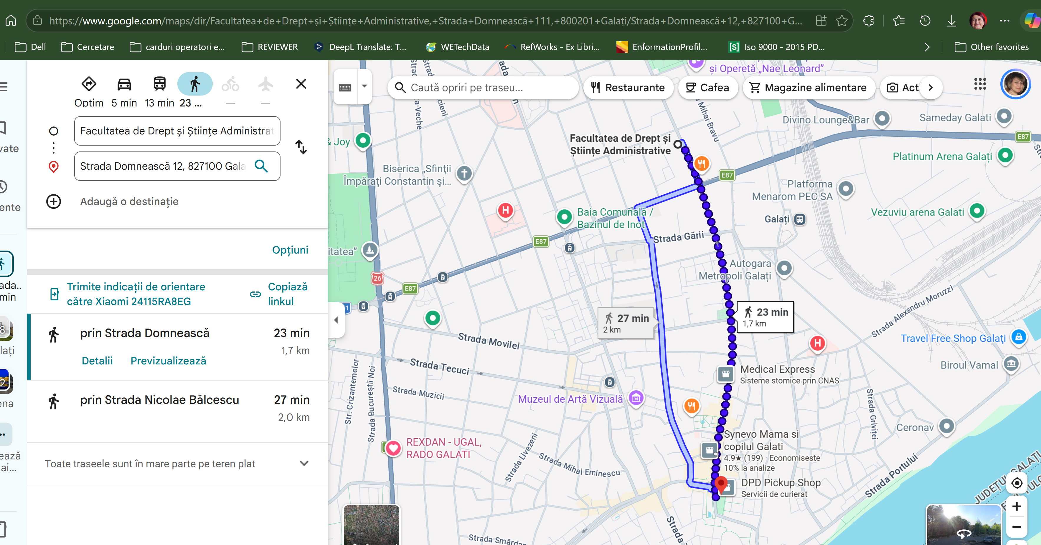
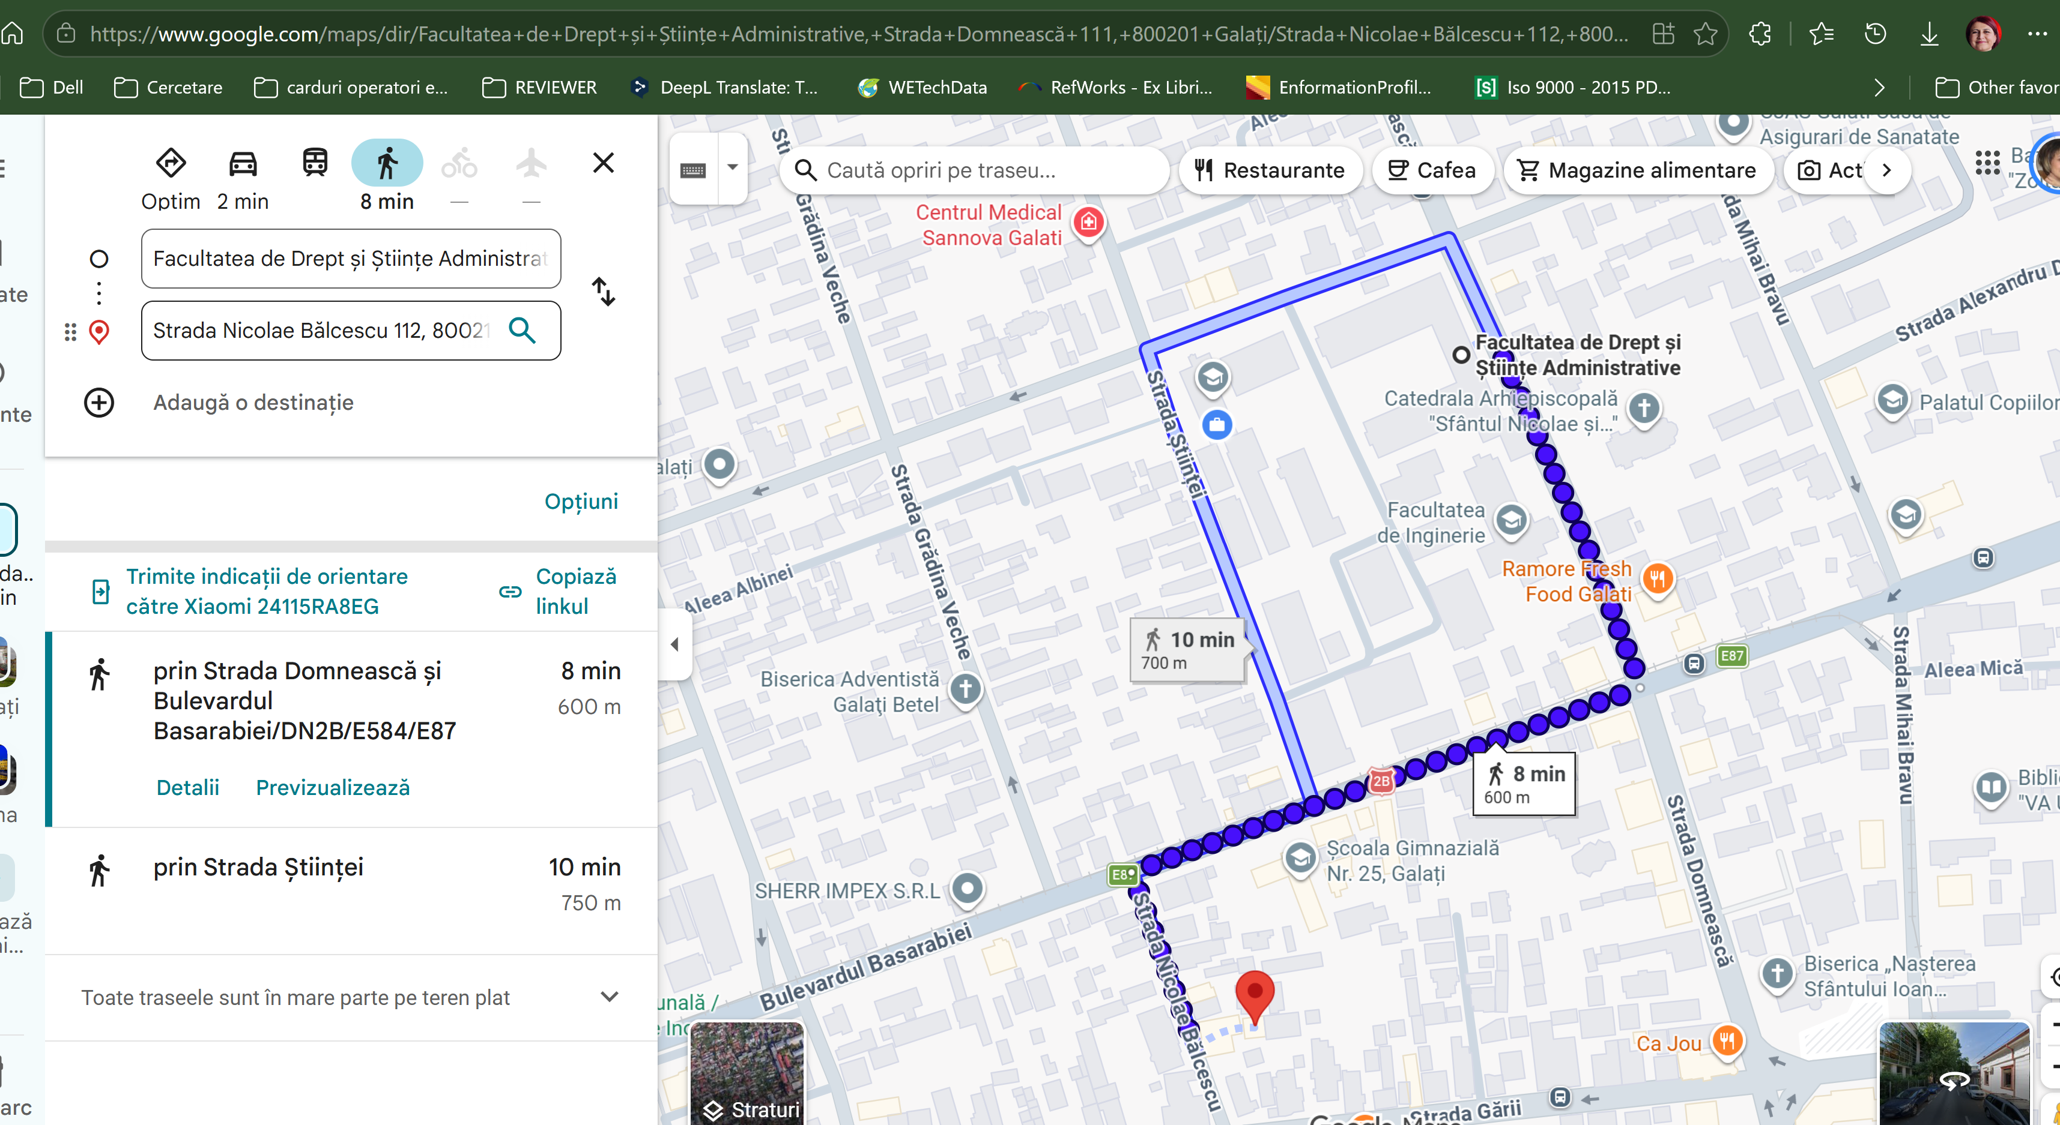
Accommodation Recommendations:
1. Vega Hotel****
Vega Hotel, Galaţi (updated prices 2026)
Facultatea de Drept și Științe Administrative către UNIREA S.C.M. - Google Maps
2. Mercure Galati Centrum ****
Mercure Galati Centrum, Galaţi (updated prices 2026)
Facultatea de Drept și Științe Administrative către Strada Domnească 12, 827100 Galați - Google Maps
3. Hotel Kreta ****
Hotel Kreta, Galaţi (updated prices 2026)
Facultatea de Drept și Științe Administrative către Strada Nicolae Bălcescu 112 - Google Maps
All the hotels are in the city center and within walking distance of the venue

